Slide 1


IBM Applied Data Science Capstone
Coursera Capstone
Opening a New Shopping Mall in New Delhi, India
By: Sanjeev Nanda, March 2020

Slide 2
Business Problem : Location of the shopping mall is one of the most important decisions that will determine whether the mall will be a success or a failure
Objective: To analyze and select the best locations in the city of New Delhi, India to open a new shopping mall. This project is timely as the city is currently suffering from oversupply of shopping malls
Business question : In the city of Delhi, India if a property developer is looking to open a new shopping mall, where would you recommend that they open it?
- Business Problem & Business question

Slide 3
Data
•Data required
1. List of neighbourhoods in Kuala Lumpur
2. Latitude and longitude coordinates of the neighbourhoods
3. Venue data, particularly data related to shopping malls
•Sources of data
1. Wikipedia page for neighbourhoods
(https://en.wikipedia.org/wiki/Category:District_subdivisions_of_Delhi))
2. Geocoder package for latitude and longitude coordinates
3. Foursquare API for venue data
- Sources of data

Slide 4
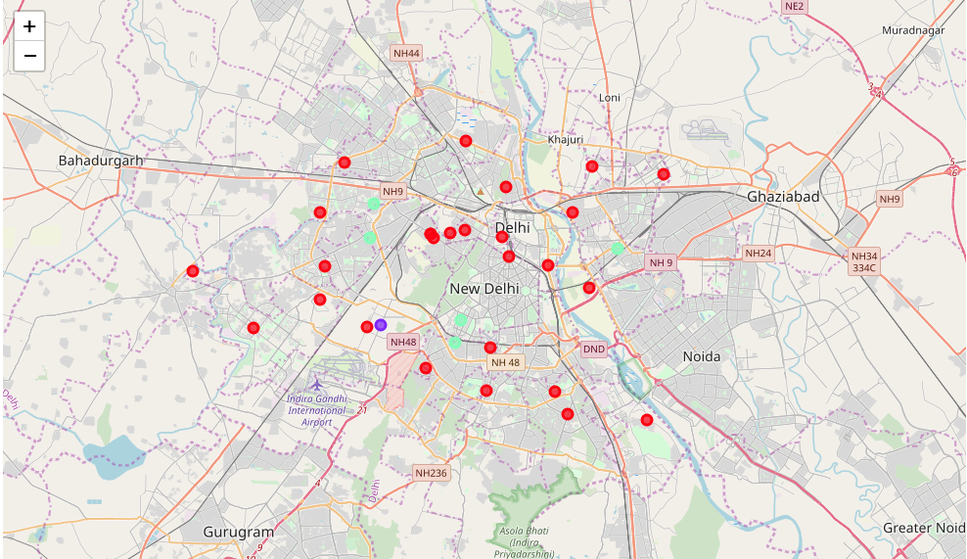
Results
•Categorized the neighborhoods into 3 clusters :
1. Cluster 0: Neighborhoods with moderate number of shopping malls
2. Cluster 1: Neighborhoods with low number to no existence of shopping malls
3. Cluster 2: Neighborhoods with high concentration of shopping malls
- Results

Slide 5
Discussion
•Most of the shopping malls are concentrated in the central area of the city
•Highest number in cluster 2 and moderate number in cluster 0
•Cluster 1 has very low number to no shopping mall in the neighborhoods
•Oversupply of shopping malls mostly happened in the central area of the city, with the suburb area still have very few shopping malls
- Discussion

Slide 6
Recommendations
•Open new shopping malls in neighbourhoods in cluster 1 with little to no competition
•Can also open in neighbourhoods in cluster 0 with moderate competition if have unique selling propositions to stand out from the competition
•Avoid neighbourhoods in cluster 2, already high concentration of shopping malls and intense competition
- Recommendations

Slide 7
Conclusion
•Answer to business question: The neighborhoods in cluster 1 are the most preferred locations to open a new shopping mall
•Findings of this project will help the relevant stakeholders to capitalize on the opportunities on high potential locations while avoiding overcrowded areas in their decisions to open a new shopping mall
- Conclusion

